Slide 1

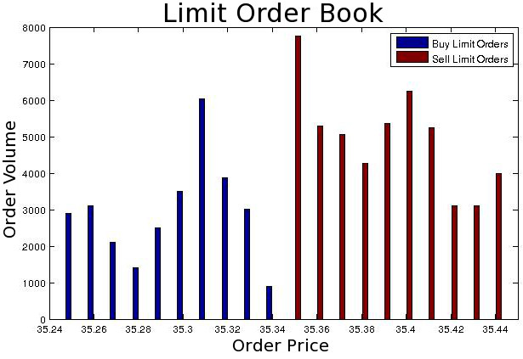
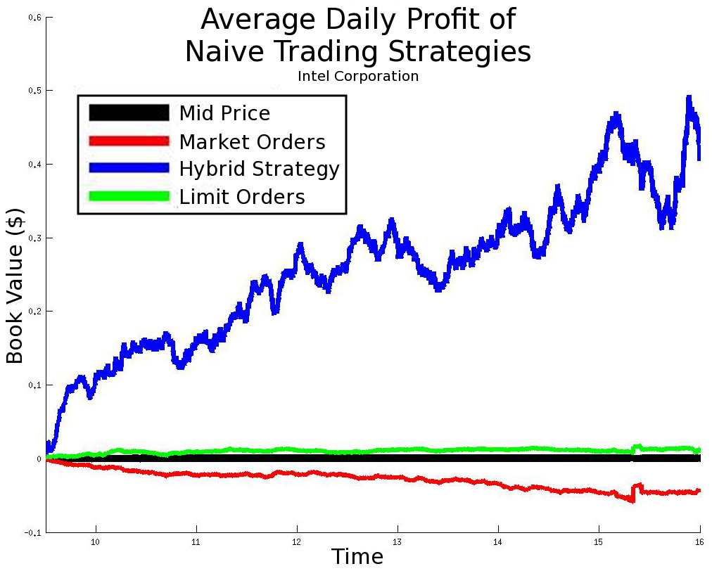
Optimal Control in Stock Trading
Statistical Arbitrage in High Frequency Algorithmic Trading
Question: Can limit order book volume imbalance successfully predict price changes?
YES
Next: Formulate as stochastic control problem and solve for optimal controller.

